Slide 1
Data Science and Five Ps of Big Data

Slide 2
How To get Value out of Big Data

Slide 3
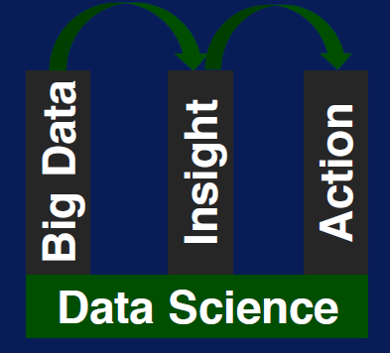

Slide 4
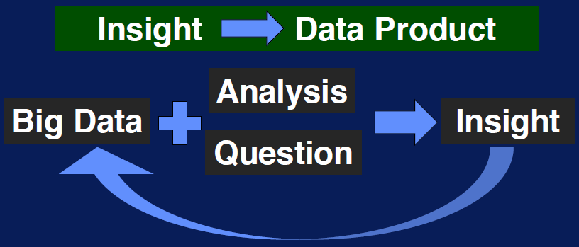

Slide 5
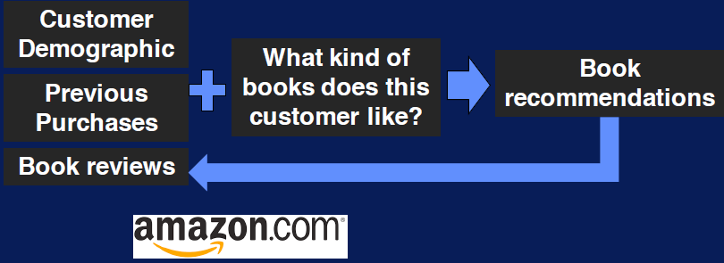
Book Recommendation

Slide 6
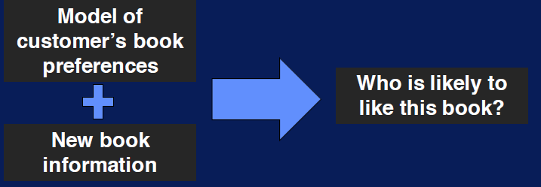
Find Potential Audience for the Book

Slide 7

Market a New Book

Slide 8
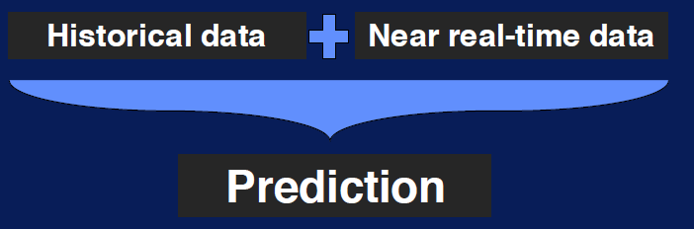
Actionable Information

Slide 9
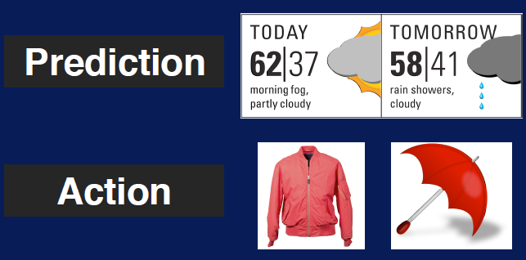
Prediction And Action

Slide 10
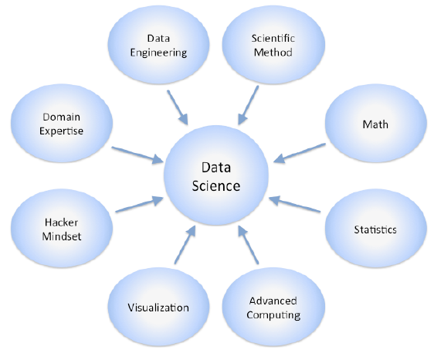
Data Science is a Team Work

Slide 11
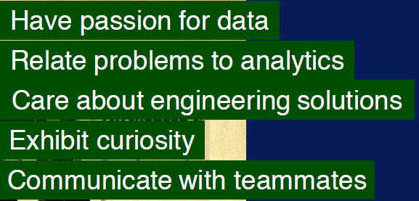
Data Science is a Team Work

Slide 12
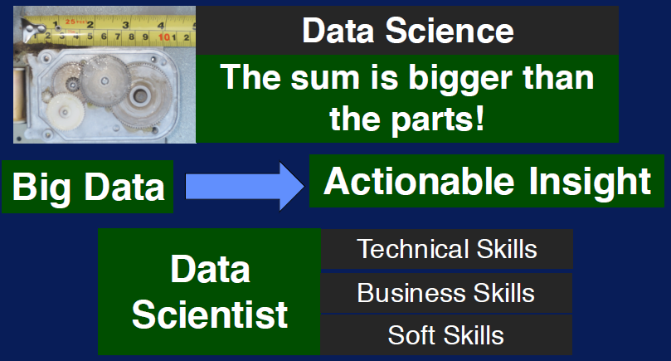

Slide 13
Building A Big Data Strategy

Slide 14
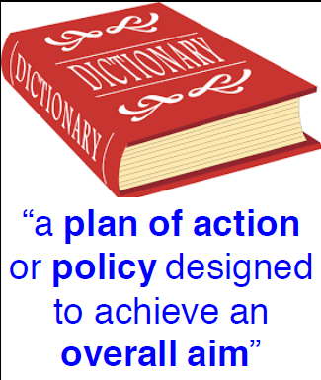

Slide 15
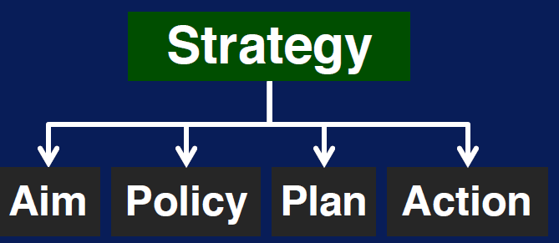

Slide 16




Slide 17

Provide Organizational Bye In…

Slide 18

Diverse Expertise
Deliver as team

Slide 19

Build In House Expertise

Slide 20
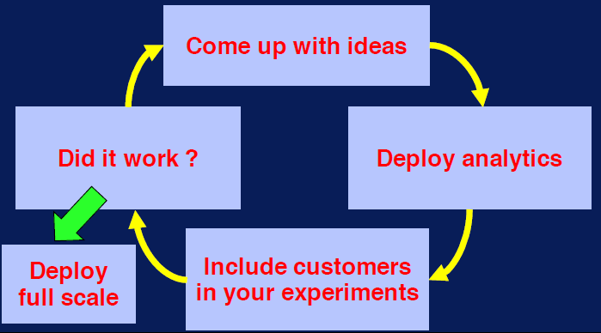
Open Mini Idea Lab

Slide 21
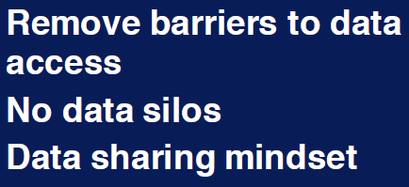
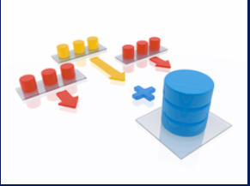
Share Data

Slide 22



Define Big data Policies

Slide 23
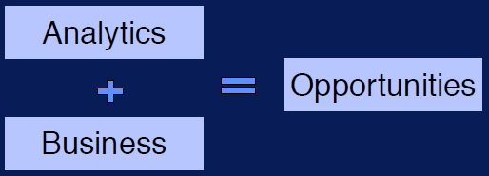
Cultivate Analytics Driven Culture

Slide 24

Adapt Strategy to your Use Case

Slide 25
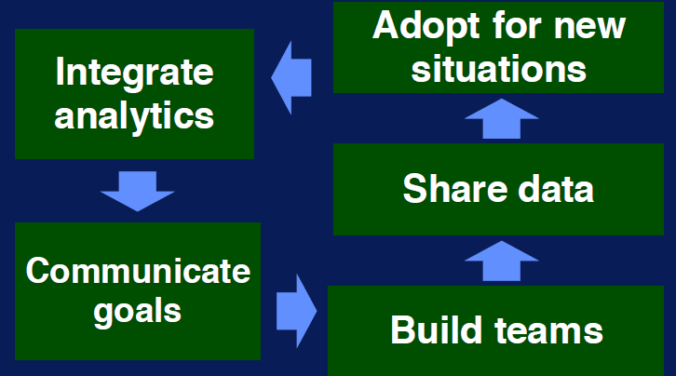

Slide 26
Five Ps of Big Data

Slide 27
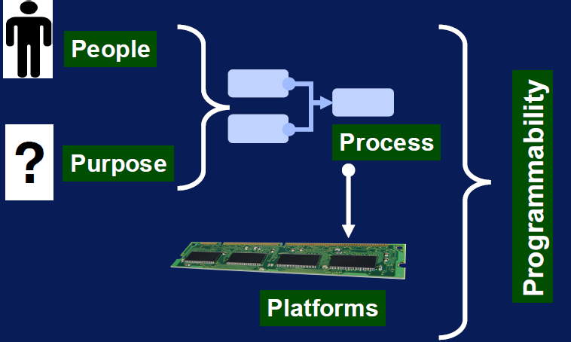

Slide 28
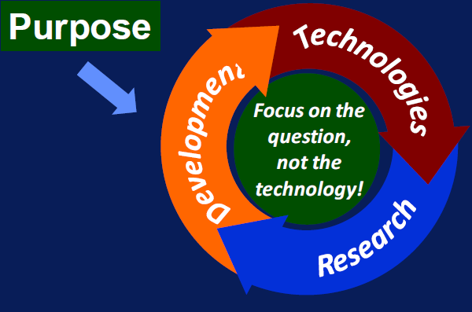

Slide 29



Slide 30
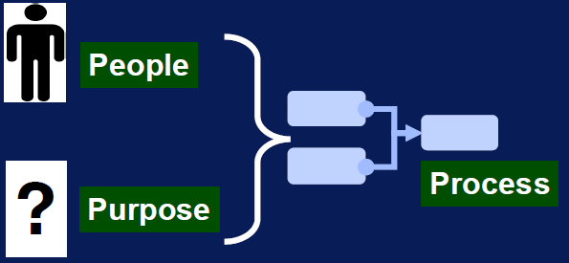
Components of Data Science

Slide 31
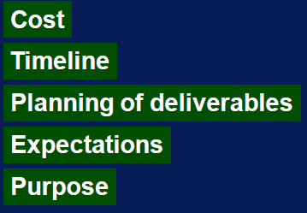
Build Metrics for Accountability

Slide 32
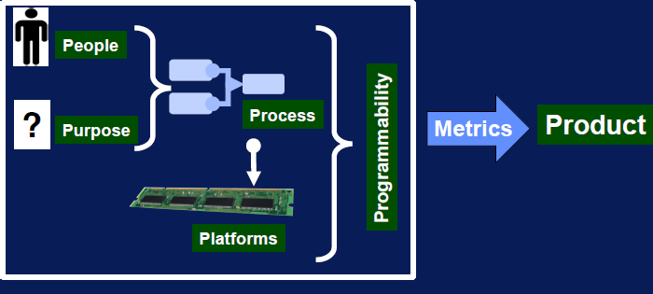

Slide 33
Steps in Data Science Process

Slide 34
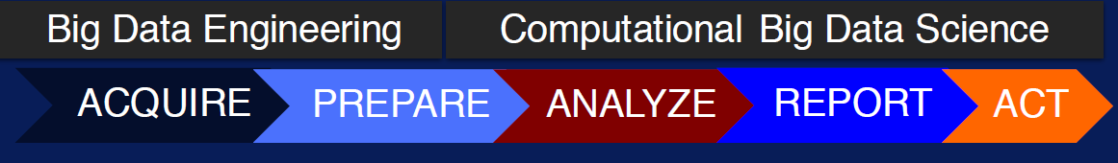

Slide 35

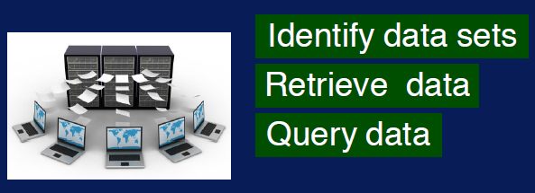

Slide 36
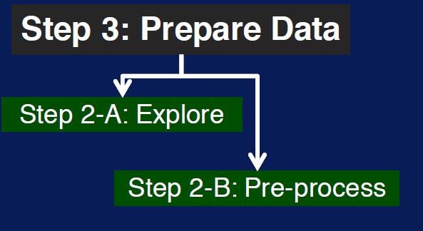

Slide 37
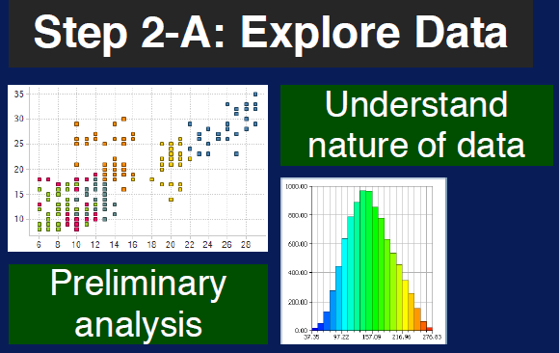

Slide 38
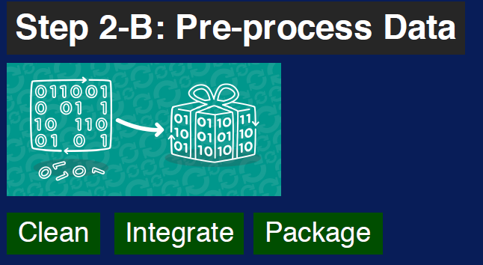

Slide 39
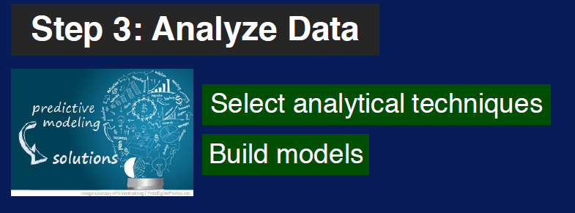

Slide 40
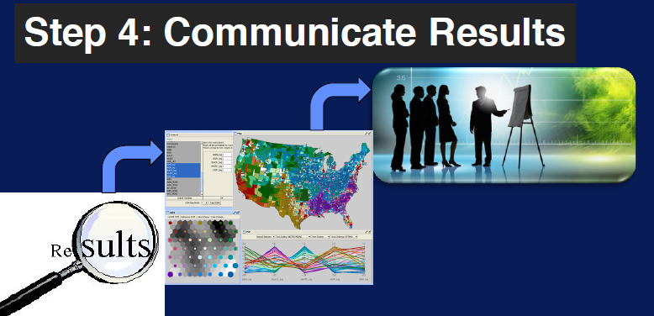

Slide 41
